Slide 1
Flow Control and Measurement
extras

Slide 2

What are extras?
extras are the solution for when there’s just too much exciting information for one presentation!
While fun and exciting, this information will not be on any Design Challenges or exams

Slide 3
How are extra slides organized?
See extra 1
When you see this symbol on an in-class lecture slide, it means that there is additional information on topic “1” found in the extra slides
Each extra slide deck will have a table of contents listing the information it contains
Ctrl+click on a tag ( ) to jump to a section!
Extra 1

Slide 4
Flow Control and Measurement
extras
Extra 1
- K_{e} for an orifice in a pipe
- “Almost Linear” Flow Controller
- Linear Flow Orifice Meter (LFOM)
- What about a turbulent Chemical Dose Contoller?
- Float valve head loss
- Linear Chemical Dose Controller: more info
- Surface tension
- Assorted other
Extra 2
Extra 3
Extra 4
Extra 5
Extra 6
Extra 7
Extra 8

Slide 6

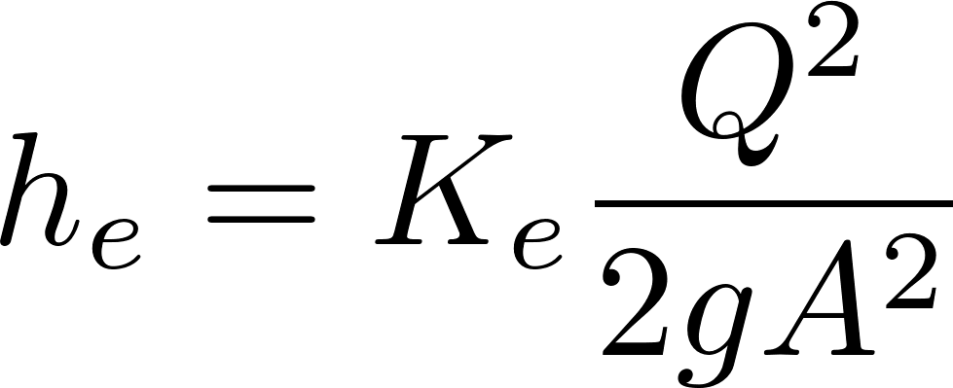
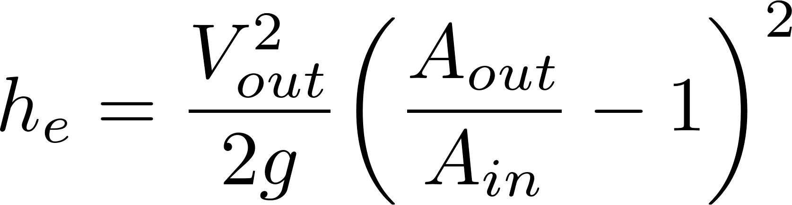
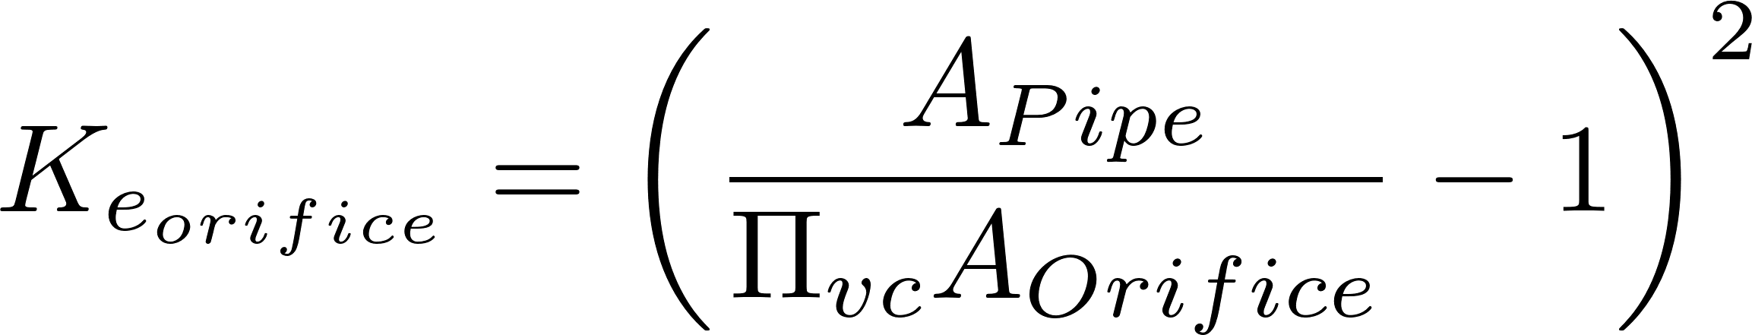

Minor Loss Coefficient for an Orifice in a Pipe (D_{Orifice} < < D_{pipe})
extra
e for expansion
Minor loss coefficient
Expansion losses
This is V_{out}, not V_{in}
h_{L}
Vena contracta area
D_{Orifice}
D_{Pipe}
Notes:
Draw the orifice case in detail showing expansion zone

Slide 7

Minor Loss Coefficient for an Orifice in a pipe
extra
The expansion starts from the vena contracta
Notes:
Draw the orifice case in detail showing expansion zone

Slide 8
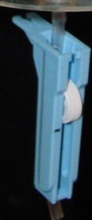
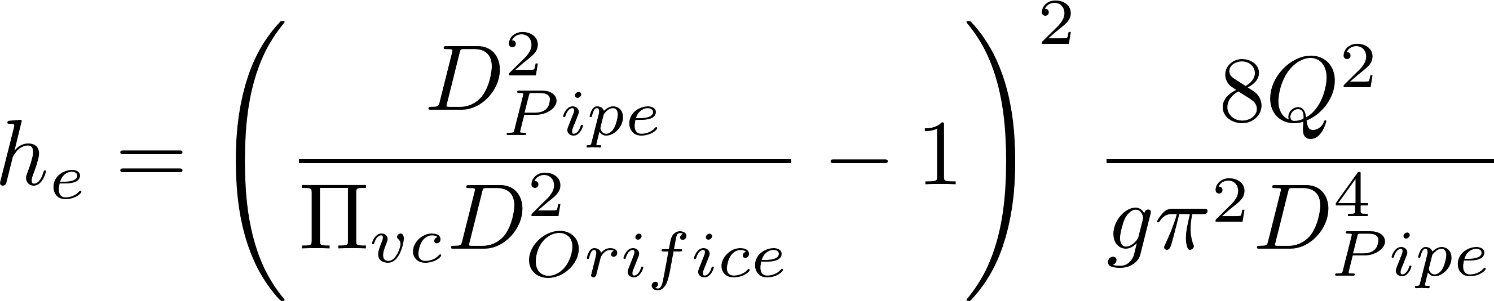
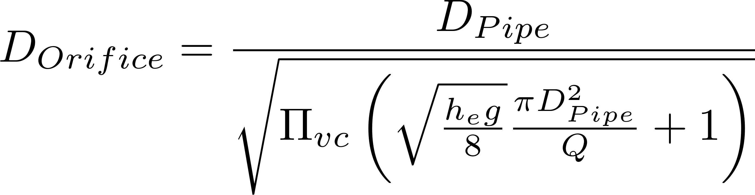
Equation for the diameter of an orifice in a pipe given a head loss
extra
Minor losses dominate, thus h_{e} = h_{L}
Where do changes in pressure occur?
Where does head loss occur?

Slide 9
2.
“Almost Linear”
Flow Controller

Slide 10
AguaClara Dose Control History
extra
control
measurement
Laminar tube flow and simple orifice
Laminar tube flow and linear flow orifice meter
Dose controller that combines laminar tube flow and linear flow orifice meter
Dose controller with orifice flow for both flow control and measurement
Dose controller with variable valve and simple orifice

Slide 11

Requirements for a Flow Controller
extra
Easy to Maintain
Easy to change the flow in using a method that does not require trial and error
Needs something to control the level of the liquid (to get a constant pressure)
Needs something to convert that constant liquid level into a constant flow
Notes:
Constant head
Variable head loss
Tube as resistance element and also used to vary the head loss

Slide 12
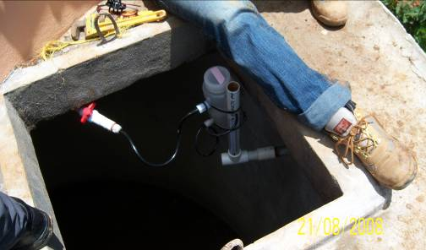


Hypochlorinator Fix
extra
Access door to hypochlorinator tank
Overflow tube
Chlorine solution
Access door to distribution tank
Raw water entering distribution tank

Slide 13
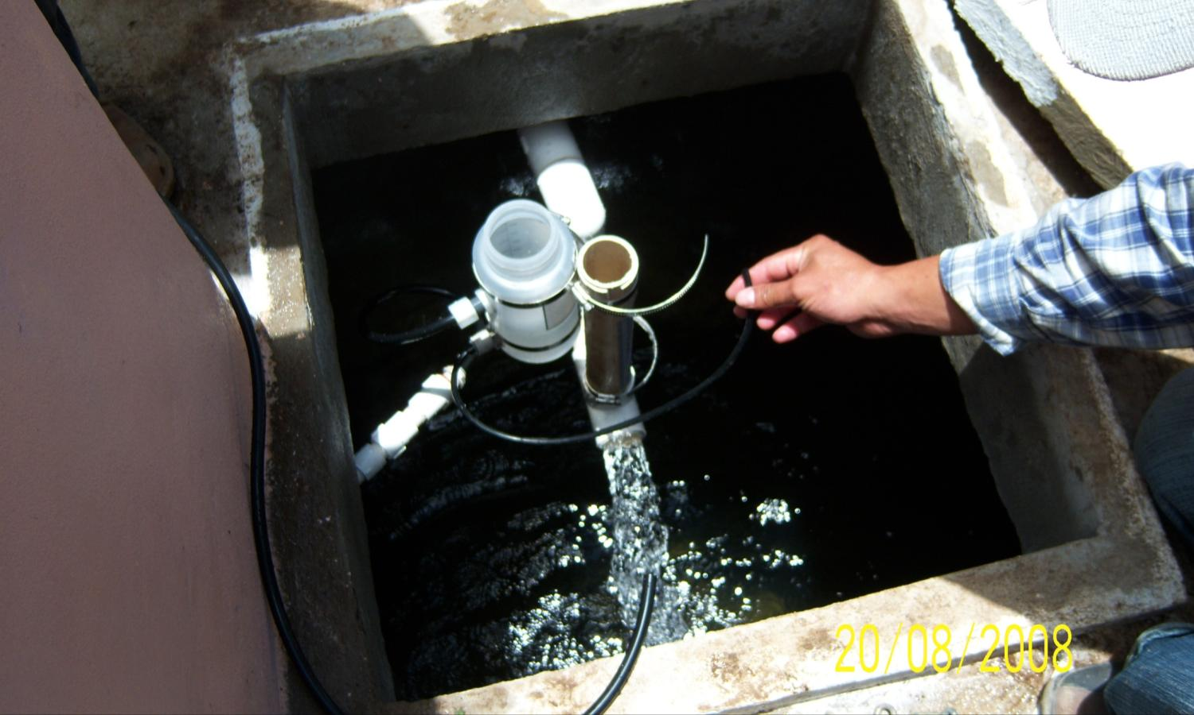
Installing a Flow Controller for dosing Chlorine
extra

Slide 14
3.
Linear Flow Orifice Meter (LFOM)

Slide 15
Linear Flow Orifice Meter (LFOM)
extra
Holes must be drilled with a bit that leaves a clean hole with a sharp entrance (hole saws are not a good choice) (Don’t deburr the hole!)
The sharp entrance into the hole is critical because that defines the point of flow separation for the vena contracta
The zero point for the LFOM is the bottom of the bottom row of orifices

Slide 16
This system is no longer used,
it has been eclipsed by CDC
extra
What must the operator do if the plant flow rate decreases?
Wall height of entrance tank
5 cm
Max water level in entrance tank
Linear Flow Orifice Meter
Raw water
20 cm
Min water level in entrance tank
5 cm
Max water level in floc tank
? cm
Bottom of entrance tank

Slide 17
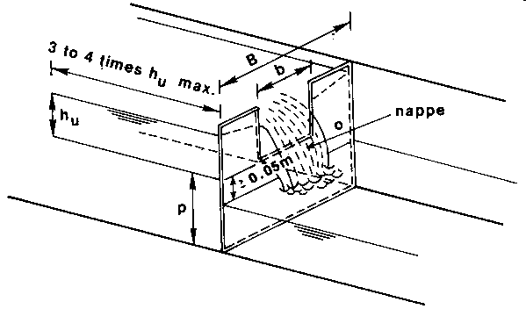
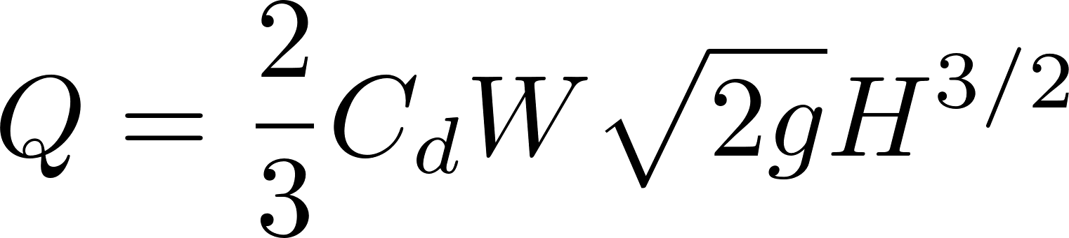
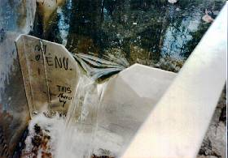
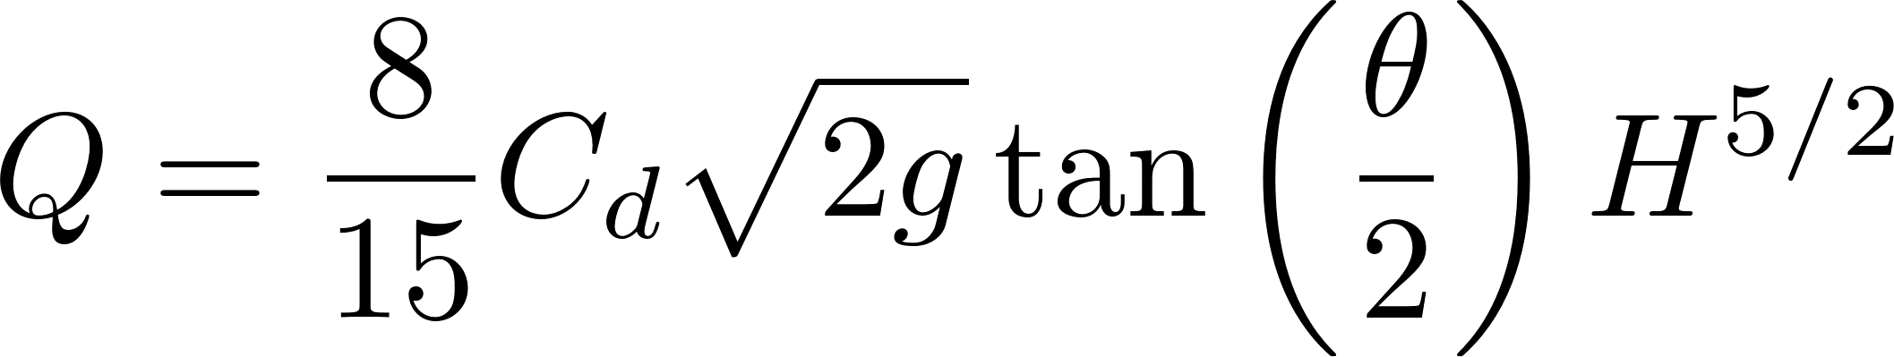
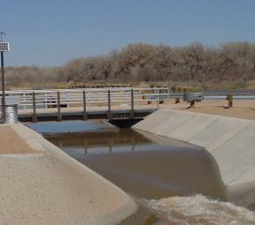
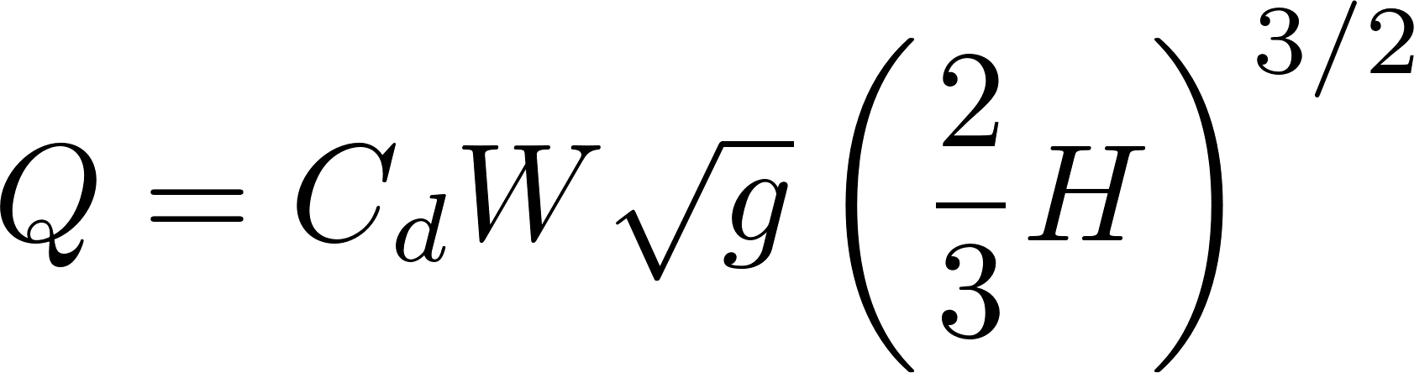
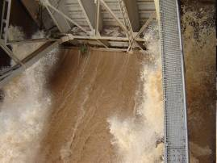
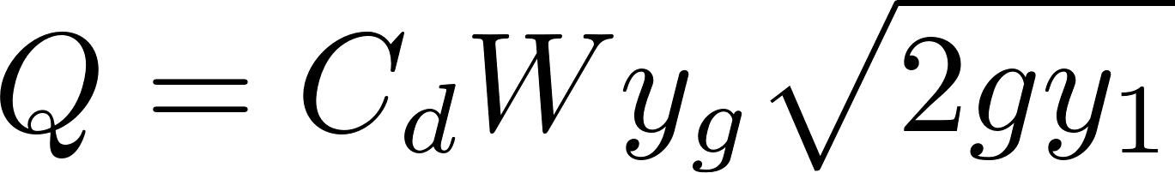
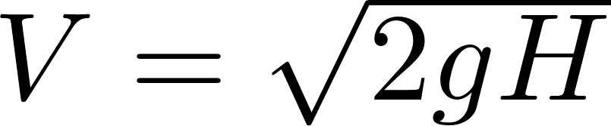
Open Channel Flow Relationships
extra
Sharp-Crested Weir
Explain the exponents of H!
V-Notch Weir
Broad-Crested Weir
Sluice Gate (orifice)
Notes:
Sharp crested weir www.fao.org/docrep/T0231E/t0231e4g.gif
Broad crested weir http://mrgcd.com/cms/kunde/rts/mrgcdcom/Docs/712740416-10-12-2007-11-33-00_files/image006.jpg

Slide 18
4.
What about a turbulent Chemical Dose Controller?

Slide 19
Extending the range of the flow controllers
extra
A single laminar flow controller will not be able to deliver sufficient alum for a large plant
Could you design a turbulent-flow flow controller?
Could we go non linear with both flow measurement and flow control to get a simple design for larger water treatment plants?
Clogging will be less of an issue with larger flows
What are our options for relationships between flow rate and head loss?
Notes:
Easy option is to use multiple LFOMs in parallel, but that is difficult for
Learn from the Sutro weir Use a Sutro weir or LFOM design for the flow controller.

Slide 20
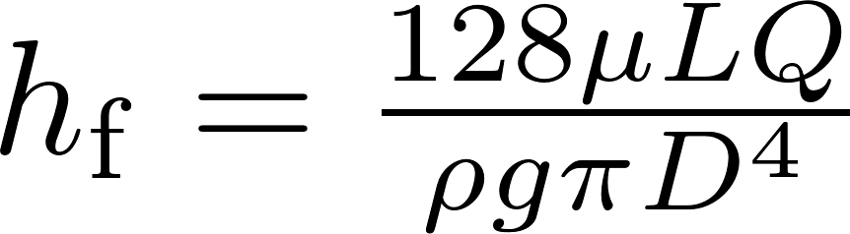
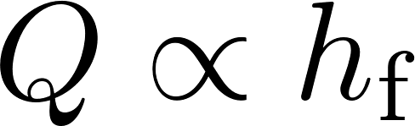
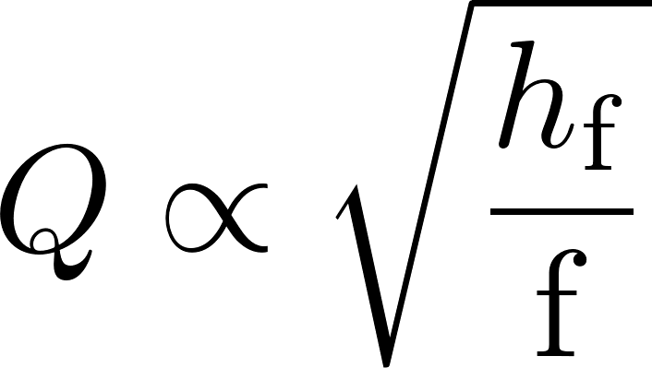
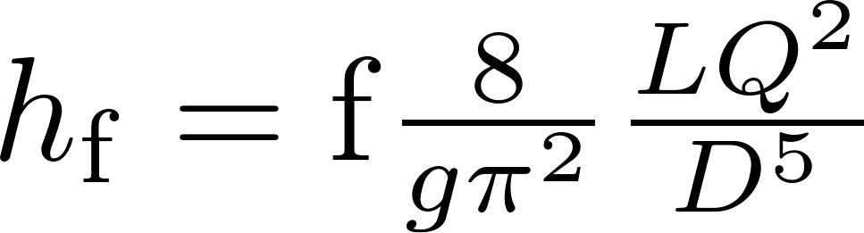
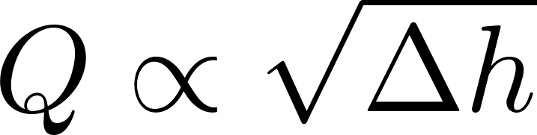
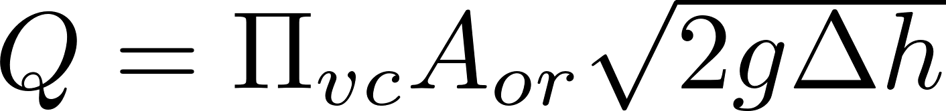
Closed Conduit Flow options for Flow Controllers
extra
Governing equation
Range Limitations
Laminar flow in a tube
Turbulent flow in a tube
Orifice flow
Low flow rates
High flow rates to achieve constant f
Valid for both laminar and turbulent flow!

Slide 21
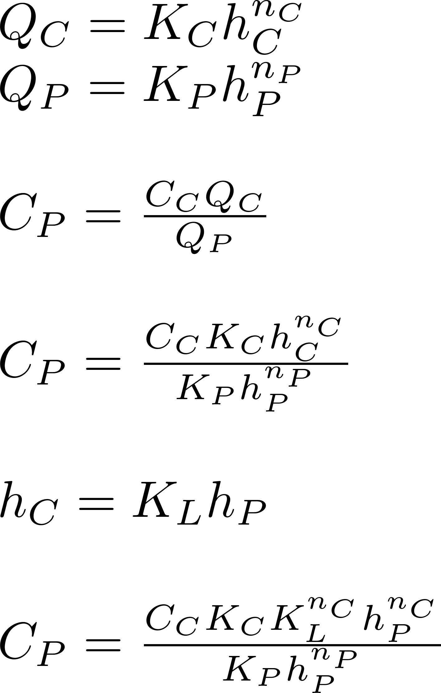
Dose Controller with nonlinear scale
extra
General Flow – Head Loss relationships for chemical feed and plant flow
Concentration of the chemical in the plant
Connect the two heads with a lever, therefore the two heads must be proportional
Is the plant concentration constant as the plant flow rate changes?

Slide 22
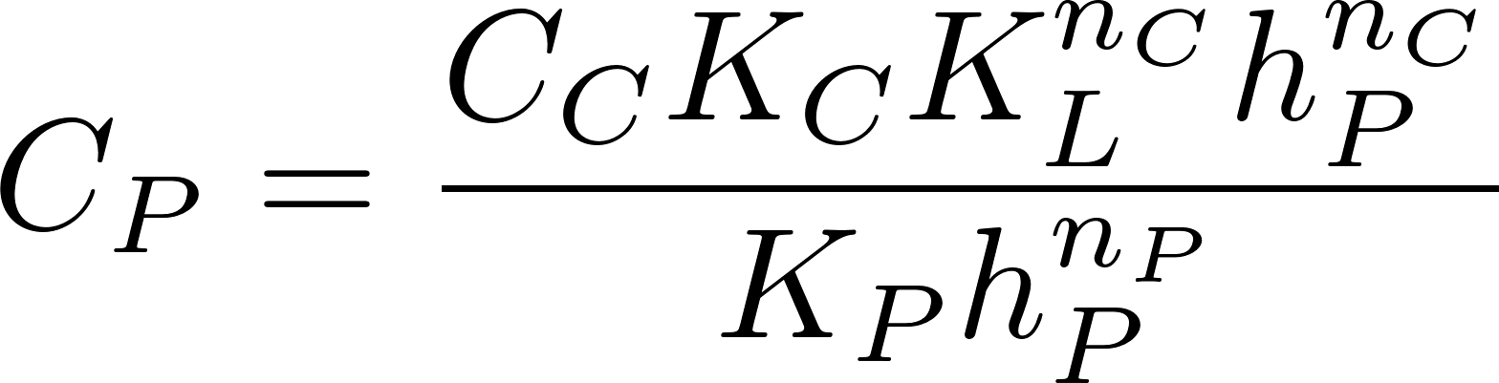
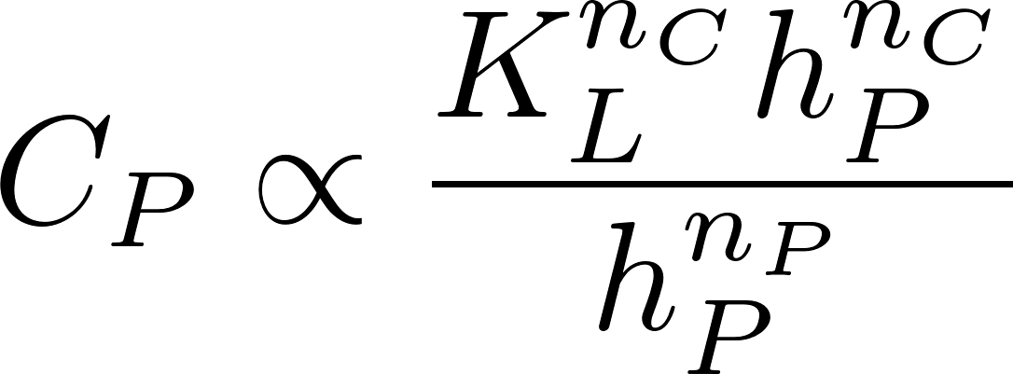
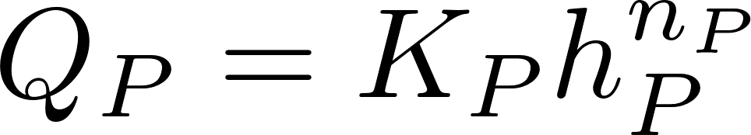
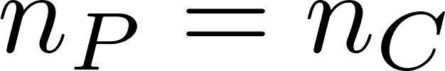
Constant dose with changing plant flow requirement
extra
What must be true for C_{p} to be constant as head loss, h_{p} changes?
What does this mean?
What are our options?

Slide 23
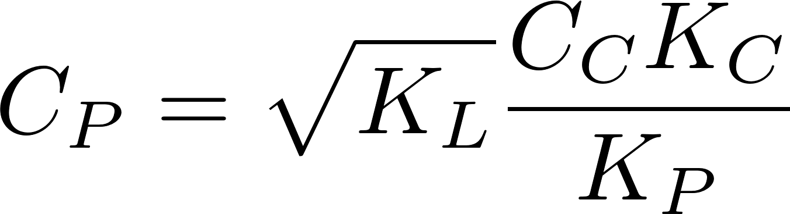
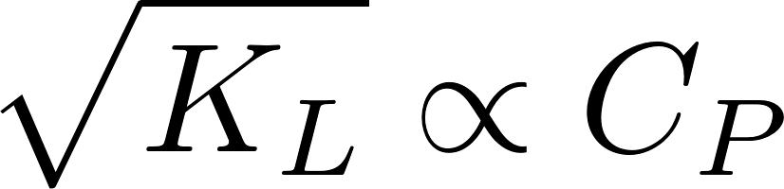
Dose scale on the lever arm?
extra
K_{L} is the ratio of the height change of the float to the height change of the flow controller
This relationship makes it difficult to accurate control a wide range of alum dosages on a reasonable length lever
Pivot Point
8
10
12
14
16
18
20
Alum dose (mg/L)

Slide 24
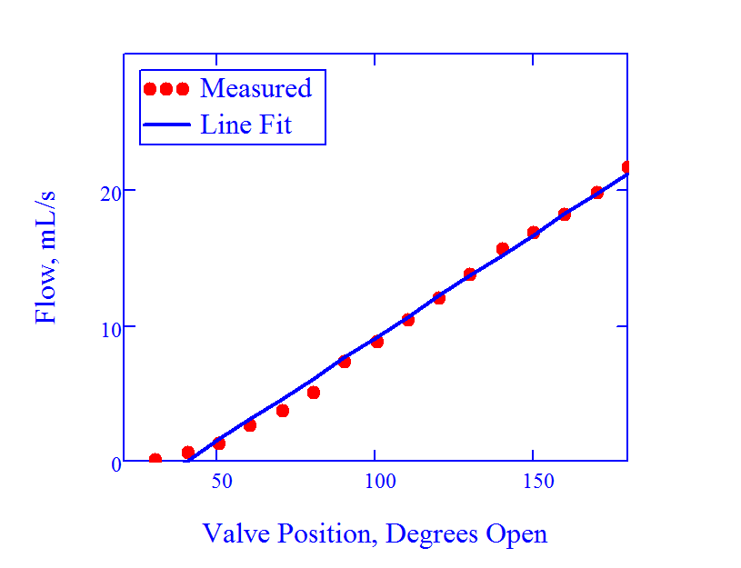
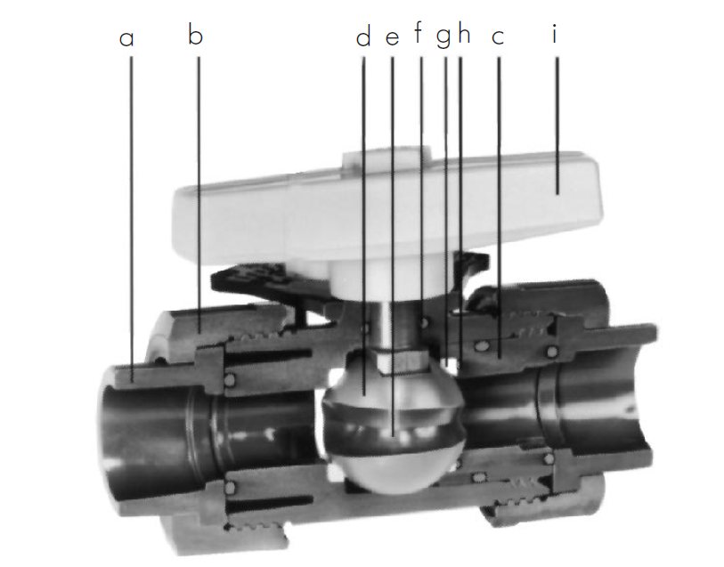
Variable dosing valve: For coagulant dosing for plant flows above 100 L/s
extra
Photo courtesy of Georg Fischer
Piping Systems
This method has not yet been attempted. The dose will be set by turning the valve. The valve will replace the head loss tube. The transition to open channel flow will be on a lever that tracks plant flow rate but no slider will be required. The exit from the entrance tank will be a simple orifice system. The system will still respond to plant flow changes correctly.
Notes:
Monica Hill’s research https://confluence.cornell.edu/display/AGUACLARA/High+Flow+Dose+Controller

Slide 25
5.
Float valve head loss

Slide 26

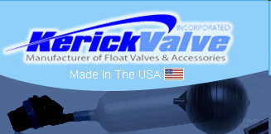
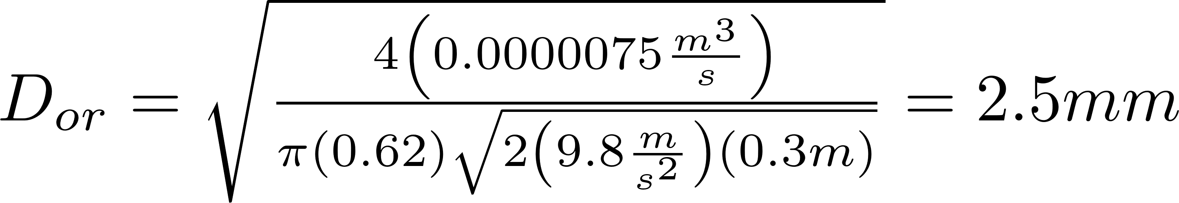
Float Valve Head Loss
extra
What orifice diameter is required for a flow of 7.5 mL/s if we don’t want more than 30 cm of head loss?
http://www.cdivalve.com/products/float-valves/pvc-float-valves

Slide 27
6.
Linear Chemical Dose Controller: more info

Slide 28
Making Minor Losses Minor
extra
Eliminate curvature in the dosing tubes; keep them straight and taut (in tension)
Use fittings that have a larger ID than the tube; it will be necessary to stretch the tubing to get it on the larger diameter barbed fittings

Slide 29
Doser Calibration Steps (whenever the dosing tubes are replaced or elevations are varied)
extra
Make sure the lever is level at zero flow (adjust the length of the cable to the float)
The doser is a linear device and thus when we calibrate it we have ____ adjustments
__________ the zero flow setting (adjust the height of the constant head tank)
__________ maximum flow rate (we will adjust this by adjusting the length of the dosing tubes if needed)
2
Intercept
Slope

Slide 30


Tube Diameter for Flow/Dose Controller (English tube sizes)
extra
Increasing the viscosity decreases the length of the tubes
Higher flow rates can be attained
Viscosity = 1.8 mm²/s, ΣK_{e} = 2

Slide 31
Tube Diameter for Flow/Dose Controller (Metric tube sizes)
extra
Viscosity = 1.0 mm²/s, ΣK_{e} = 2

Slide 32
Tube Diameter for Flow/Dose Controller (Metric tube sizes)
extra
It should be possible to achieve flows of 8.7 mL/s using the 5 mm diameter tubes
Viscosity = 1.8 mm²/s, ΣK_{e} = 2

Slide 33
7.
Surface tension

Slide 34

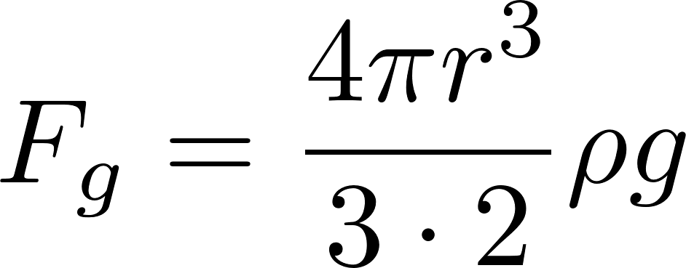
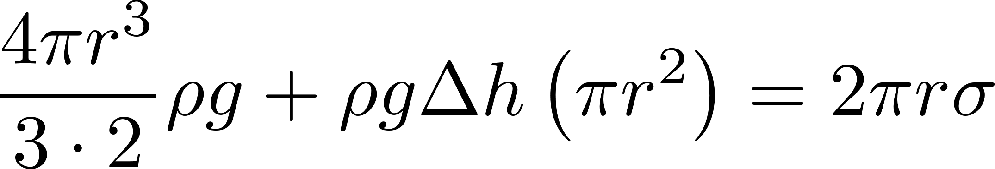
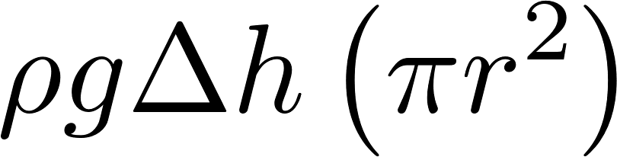
Surface Tension
extra
extra
Will the droplet drop?
Is the force of gravity stronger than surface tension?
F_{σ}=
2πrσ
F_{p}=

Slide 35
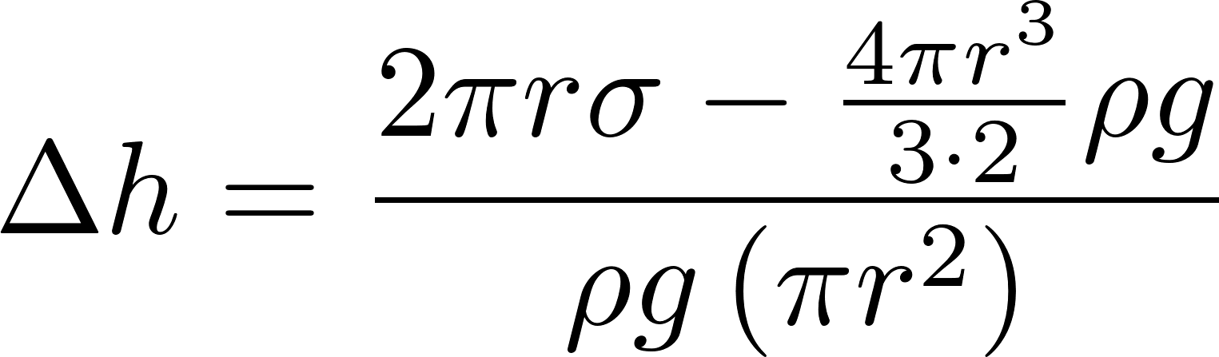
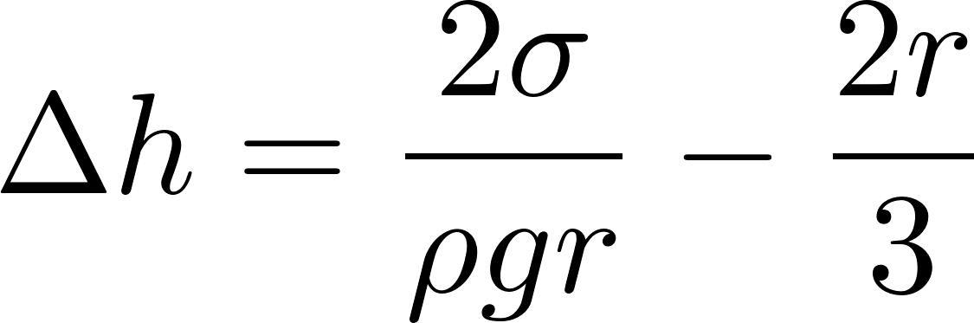
Surface Tension can prevent flow!
extra
0.080
Solve for height of water required to form droplet
0.075
Surface tension (N/m)
0.070
0.065
0.060
0.055
0.050
0
20
40
60
80
100
Temperature (°C)

Slide 36
A constraint for flow control devices: Surface Tension
extra
Delineates the boundary between stable and unstable
droplets form to right of line
Flow control devices need to be designed to operate to the right of the red line!

Slide 37
8.
Assorted other

Slide 38
Kinematic Viscosity of Water
extra
/s)
2
2.0E-06
1.5E-06
1.0E-06
Kinematic Viscosity (m
5.0E-07
0.0E+00
0
20
40
60
80
100
Temperature (C)
This is another good reason to have a building around AguaClara facilities!

Slide 39
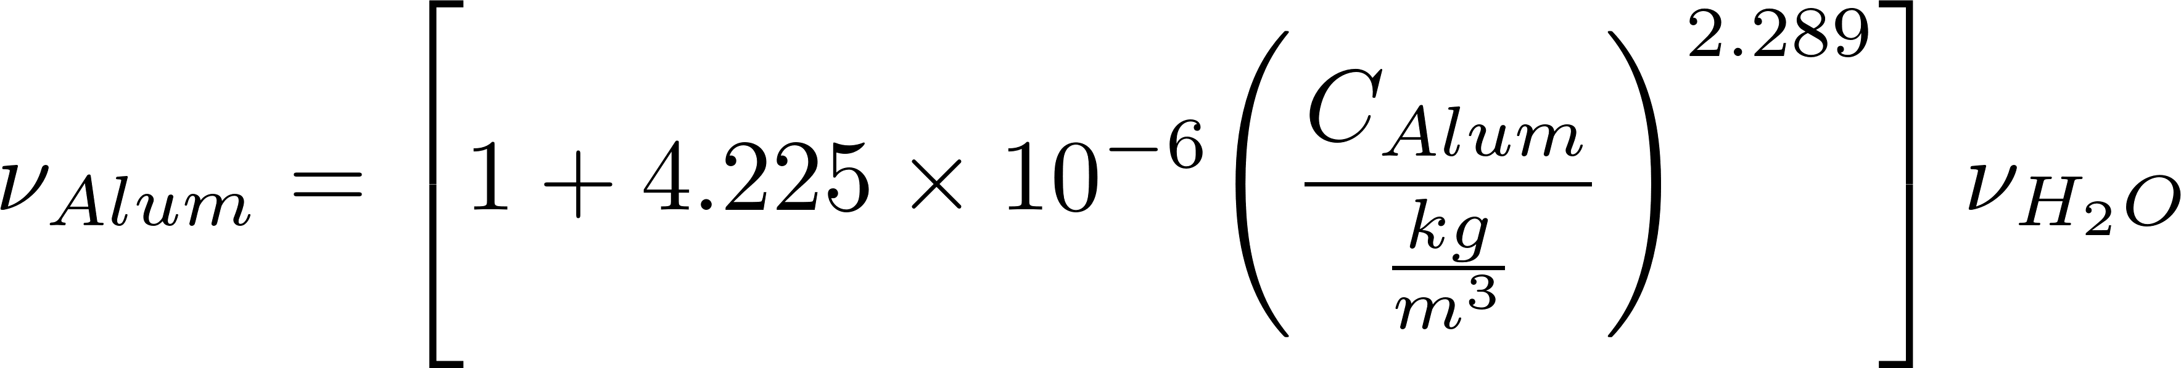
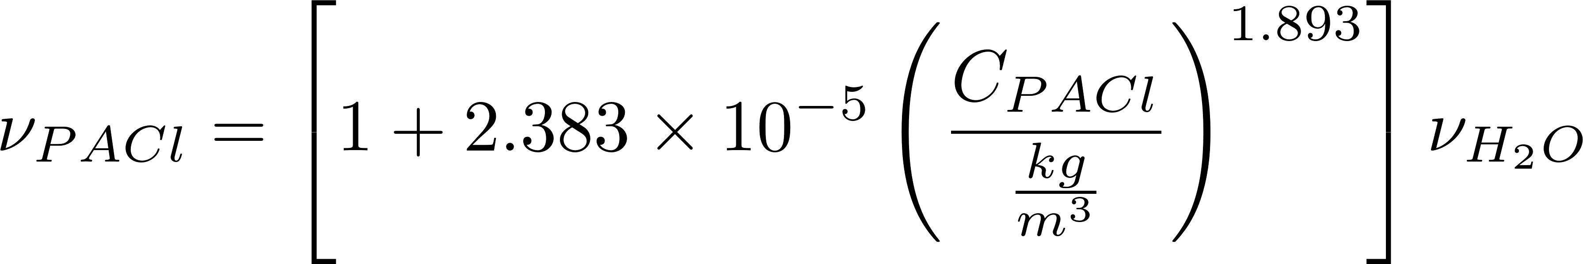
Kinematic Viscosity of Coagulants
extra
Notes:
Matthew J. Higgins Master of Engineering 2011
Karen Swetland
Interesting property that viscosity increase is almost directly proportional to concentration at 250 gm/L.

Slide 40
extra
Holding container (bucket or glass column)
Sealing pipe
Pong pipe
Driving head for sand column
HJR
Sand column
Upflow prevents trapped air
(keyword: “prevent”)!
Porous media as resistance element
What is the purpose of the sand column?
Notes:
Heather Nelson
Jeannette Harduby
Rudi Schuech
Constant resistance, vary head

Slide 41
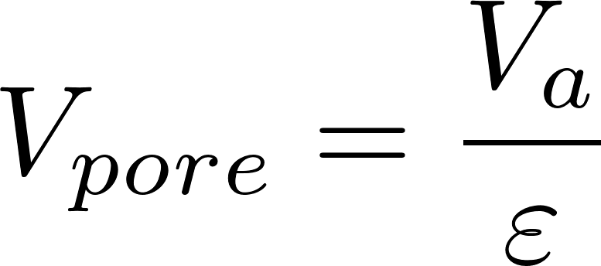
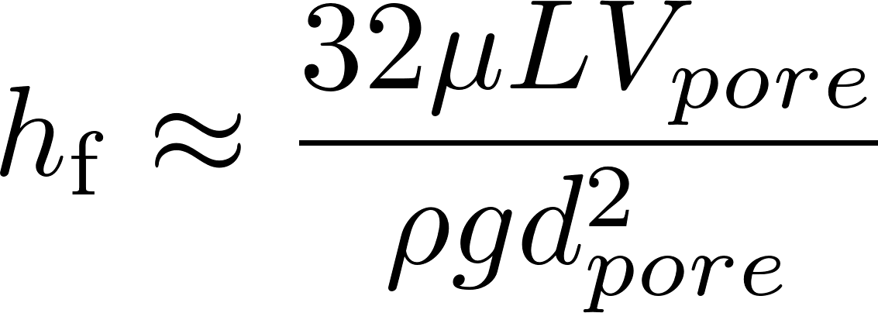
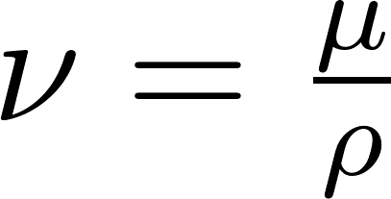
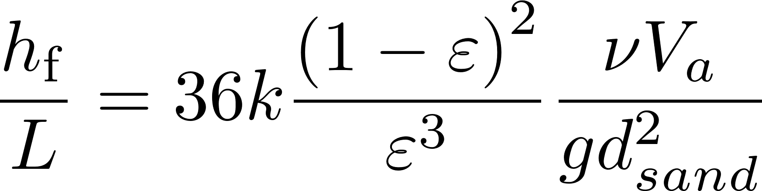
Porous Media Head Loss: Kozeny equation
extra
Velocity of fluid above the porous media
Dynamic viscosity
Kinematic viscosity
Analogy to laminar flow in a pipe
k = Kozeny constant
Approximately 5 for most filtration conditions
Notes:
Adapted from equation 8.2 in 5th edition of Water Quality and Treatment: A Handbook of Community Water Supplies by AWWA 1999.

Slide 42
Orifice Image
extra

